Slide 1

CptS 315 Fake News Prediction
Jiwoo Kim

Slide 2

Motivation for my project
Precise problem you are addressing as part of my project
High-level solution methodology
Results

Slide 3

Project that I chose: Fake news prediction

Slide 4

Motivation
Media credibility freedom and political concerns openness about personal financial interests' dedication to journalistic norms and ethics citizens’ responsiveness.
Some reporters try to cover up the truth for their own political gain, which makes harmful for people who are not trained to think logically can be easily misled by fake news.
People only read by people who hold similar views. This can cause division in the community.

Slide 5
My project will detect a given text which is fake news or not by using machine learning classifications.
This will compute the accuracy of score from fake news text and be able to classify it.
The compiler will tell you that user type input text is fake or true.
This can resolve which articles are fake or not before you read the news articles.

Slide 6
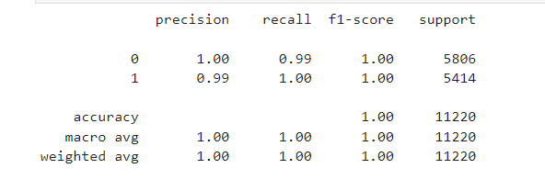
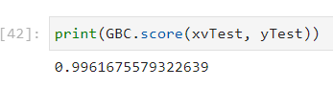
High-Level-Soultions
My programming does that I used 4 different types of machine learning classifications known as logistic regulation model, decision tree classification, gradient boosting classifier, and random forest classifier.
According to some pictures, it will tell you how accuracy your detection is and be able to compute the score by code.

Slide 7
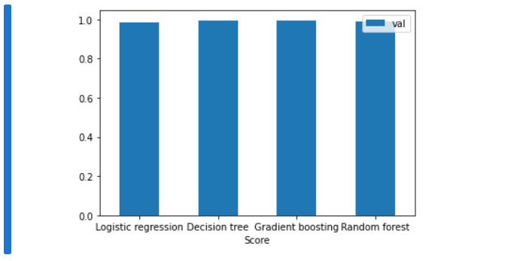
Results

Slide 8
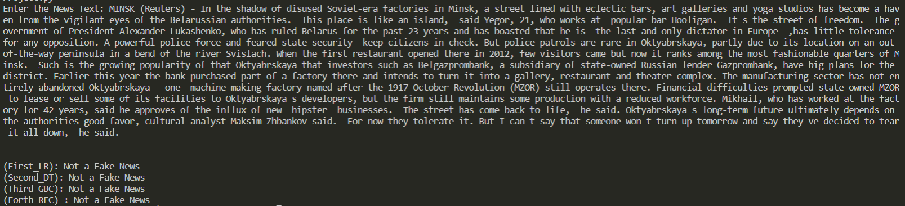
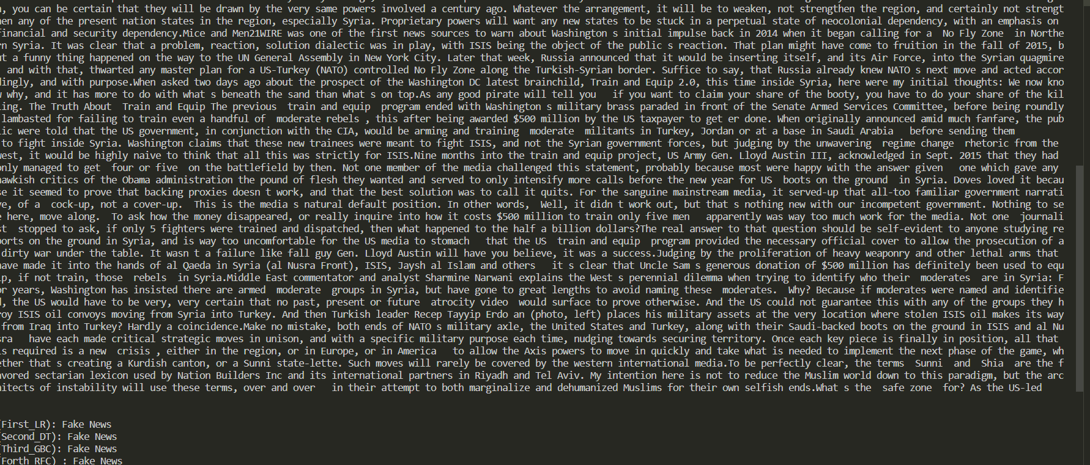
Results
User type the text from one of the “manual_testing_csv” file that I created which includes 10 row of fake and true news articles along with title, text, subject, date, and class.
Pick one of the texts and type in the user interface.
The result shown as above.

Slide 9

Thank you

